Slide 1
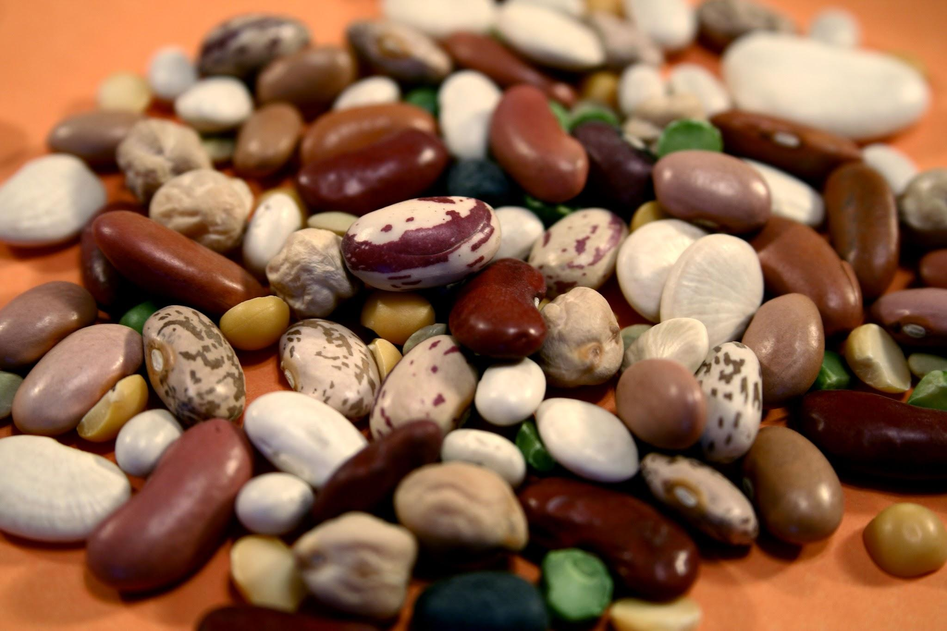
Killing Bean Classification
The Killer Beans
Ronan & Samuel

Slide 2
Introduction

Slide 3
Project Overview
Develop an classifier to distinguish between 7 different dry bean types
Significance: different bean types have different associated costs
Applications:
Bean quality control
Automated sorting systems
Disease detection

Slide 4
Data
Retrieved from UCI Machine Learning Repository
13,611 images of 7 different types of beans
Tabular dataset resulting from image segmentation and feature extraction:
12 dimension features (continuous)
4 shape forms (continuous)
1 “Class” feature (categorical)
Only necessary preprocessing: encoding target variable and scaling features
Make a stratified train/test split to ensure accurate class representation

Slide 5
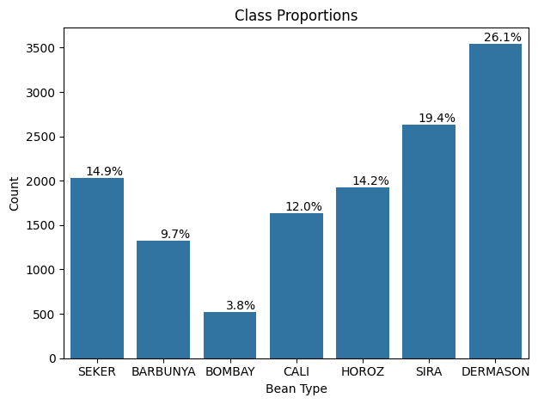

Slide 6
Methods

Slide 7
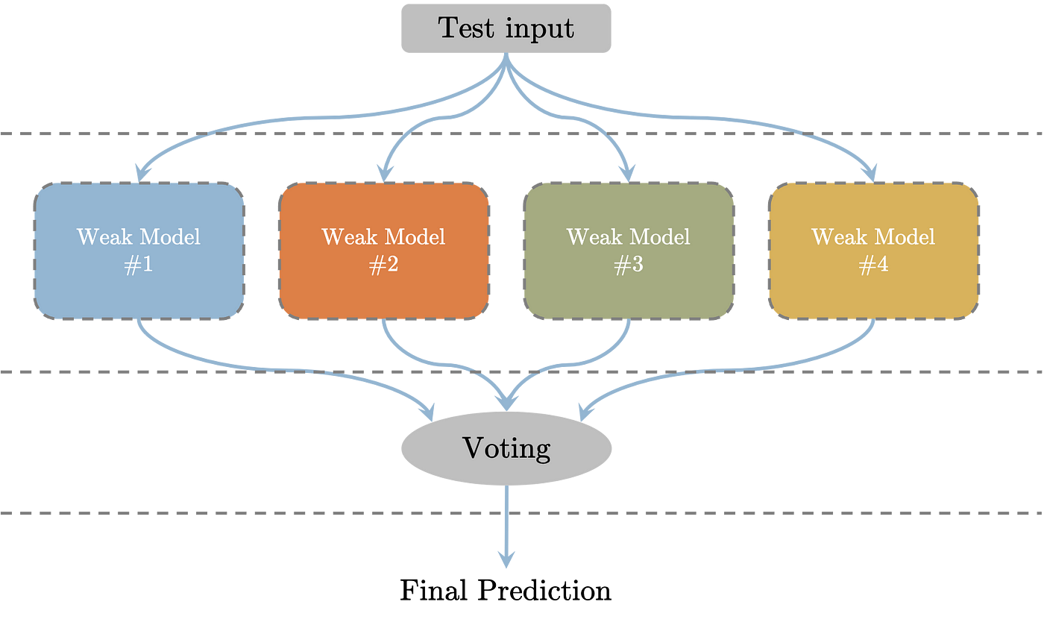
Methods
Ensemble modeling
Combining predictions from multiple models
Ensembling has been shown to improve prediction accuracy in certain scenarios (Naderalvojoud & Hernandez-Boussard, 2023)
Benchmark research on this paper uses ensembling (Shriya et al. 2023)

Slide 8
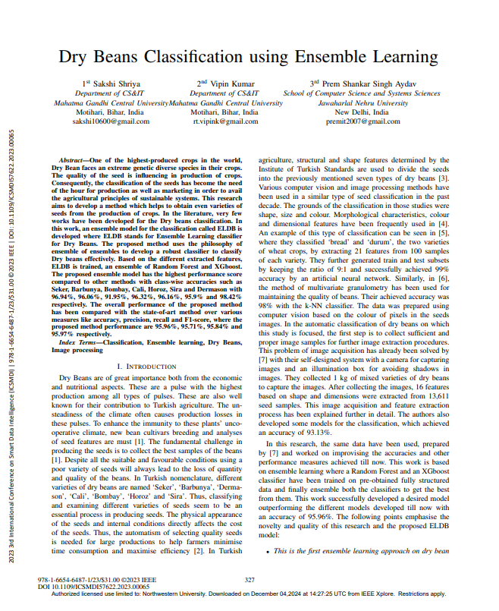
Benchmark
Utilized a model ensemble consisting of two base learners
Achieved an accuracy, precision, recall and F1-score of 95.96%, 95.71%, 95.84% and 95.97% respectively

Slide 9
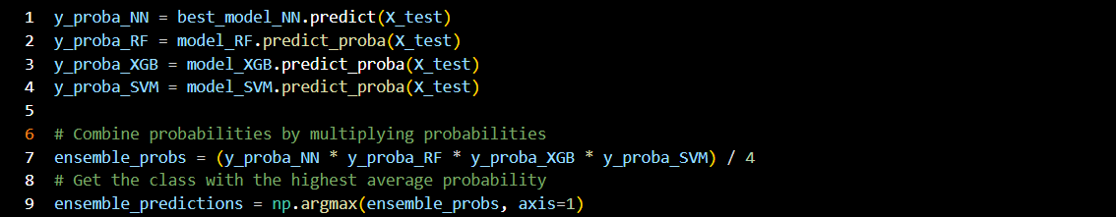
Our Approach
Model ensemble with 4 base learners
Random Forest, XGBoost, SVM, and MLP (Neural Network)
Model selection?
Voting method:
1) Simple majority voting
2) Combined instance-specific predicted probabilities from each model and selected class with highest probability

Slide 10
Results

Slide 11
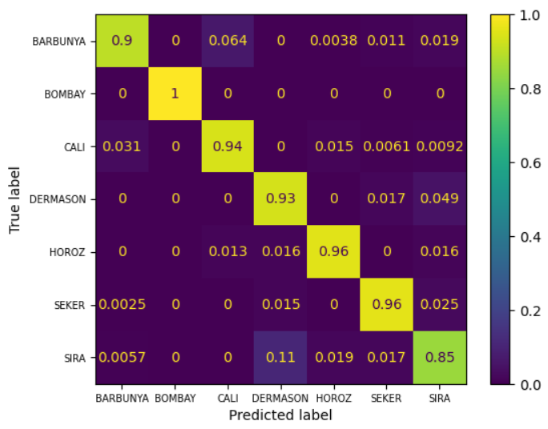
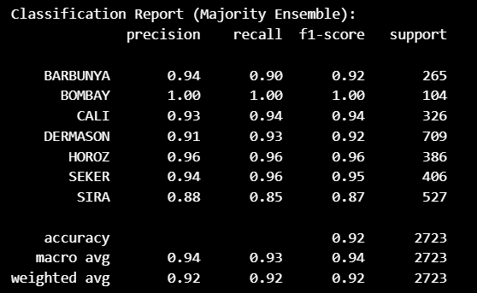
Simple majority visualized

Slide 12
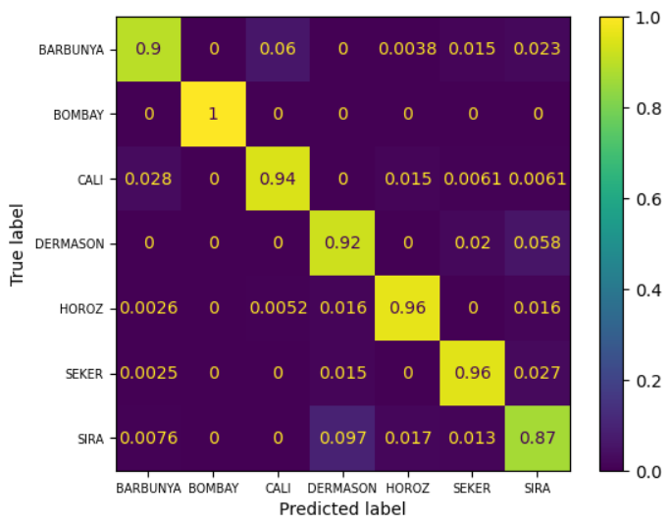
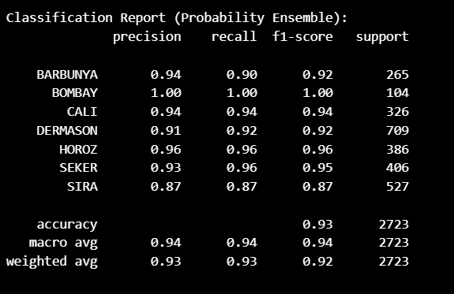
Combined probabilities visualized

Slide 13
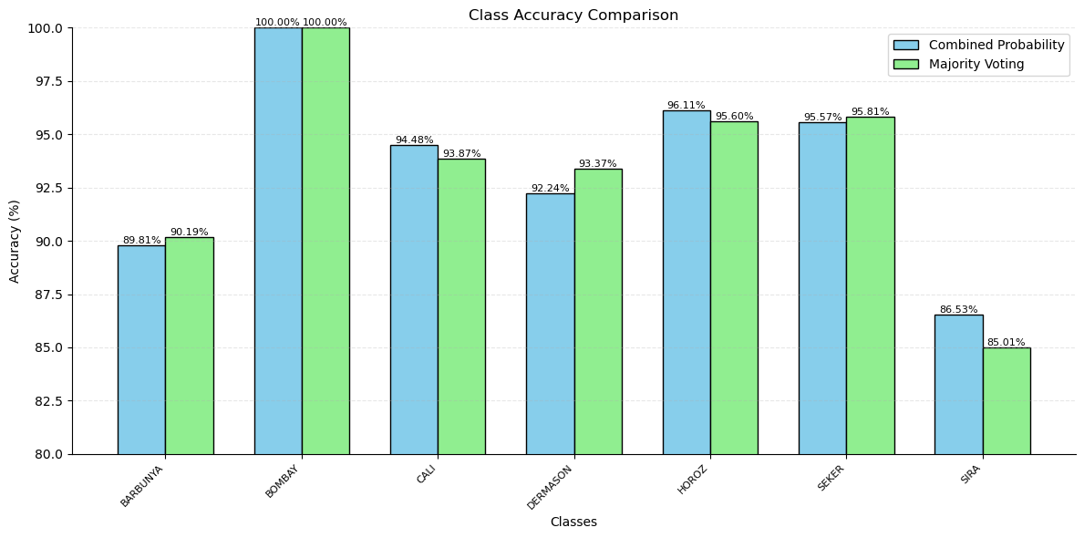
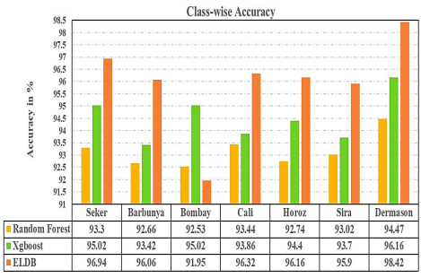
Comparison to baseline paper
Our Results:
Baseline Results:

Slide 14
Observations
Models performed best on Bombay
Least represented in the data
Models had the most difficulty distinguishing the overrepresented classes
Possible explanation could be that the less represented beans indicated unique, easily distinguishable species of beans
Most common error was confusion of dermason and sira
Top errors mislabeled them as each other
Second most was barbunya mislabeled as cali

Slide 15
Learnings

Slide 16
Lessons
How to account for unbalanced datasets when model training
Importance of examining results past “accuracy,” particularly in multiclass classification
Various metrics by which to do so
Strengths and weaknesses of neural networks
NN aren’t always the superior option!
Have been shown to have varied success on tabular data (Borisov et al., 2022)

Slide 17
Next steps?
Utilize methods to improve the models’ performances on the overrepresented classes
Experiment more with hyperparameters

Slide 18
Reflections
Is the added computing (and associated environmental) costs of using an ensemble worth the slightly increased accuracy?
For a 0.5 - 1% increase? What about for a 5 - 10% increase?
Maybe depends on the purpose of the model?
How would a larger dataset affect the respective models’ performances?
We’ve seen that performance tends to converge with increased data
Benefits of ensemble may decrease with larger dataset?

Slide 19

Thank you!

Slide 20
References
Data:
https://archive.ics.uci.edu/dataset/602/dry+bean+dataset
Research Papers:
Borisov, Vadim & Leemann, Tobias & Seßler, Kathrin & Haug, Johannes & Pawelczyk, Martin & Kasneci, Gjergji. (2022). Deep Neural Networks and Tabular Data: A Survey. IEEE Transactions on Neural Networks and Learning Systems. PP. 1-21. 10.1109/TNNLS.2022.3229161.
Naderalvojoud, B., & Hernandez-Boussard, T. (2024). Improving machine learning with ensemble learning on observational healthcare data. AMIA ... Annual Symposium proceedings. AMIA Symposium, 2023, 521–529.
S. Shriya, V. Kumar and P. S. Singh Aydav, "Dry Beans Classification using Ensemble Learning," 2023 3rd International Conference on Smart Data Intelligence (ICSMDI), Trichy, India, 2023, pp. 327-334, doi: 10.1109/ICSMDI57622.2023.00065.

